Slide 1

CSS Styles
Week 3

Slide 2
Styles
The next step in giving your web pages a professional appearance is the use of styles. Up to this point you have used the default styles provided by HTML and have applied formatting tags to each example of the text that you want to alter.
For one or two pages this is not a problem however being consistent over a website made up of 100+ pages would be extremely time-consuming if not nearly impossible using this technique. Variations would occur between pages and the net result would be a site which seemed like a patchwork.
In addition HTML5 does not allow the use of many of the formatting tags and attributes.
Styles allow the user to define how they want a particular style to look once in a document so all occurrences of the tag in the document are formatted the same way. In the following example

Slide 3
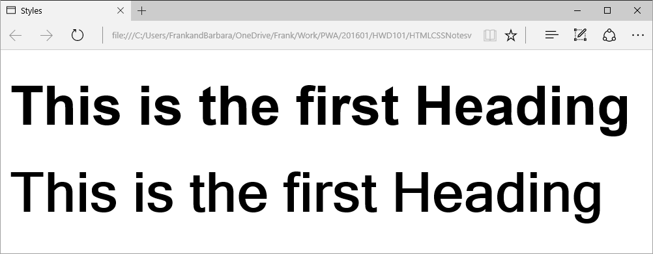
The two headings look similar enough that if they were separated by a screen it may not be immediately obvious that they are not the same. If we look at the source code, the difference is clear

Slide 4
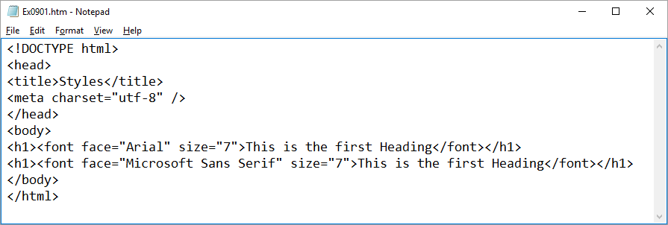
example
The font face of the headings is different. If this difference occurs several times in the same document, it will give an inconsistent and unprofessional look.
If the following code were used then the problem would not happen

Slide 5
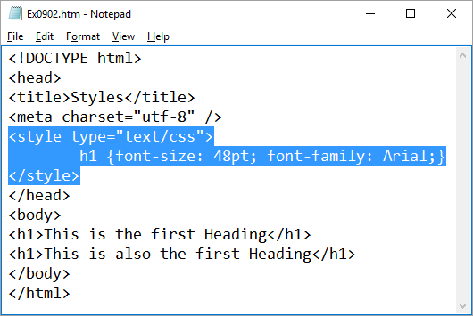
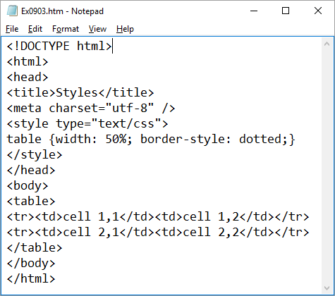
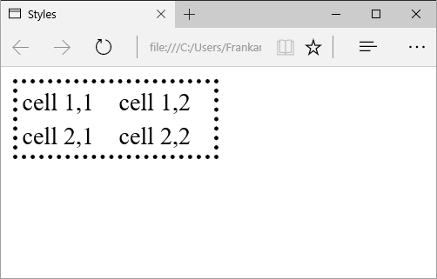
The size and font face for the h1 style is defined once at the start of the document so all uses of the h1 tag in the document will be formatted exactly the same.
A second example uses styles to set the format of the table tag
Notice that the border is dotted and the table takes up 50% of the width of the window.

Slide 6
CSS Stylesheets
The styles used in the previous lesson help to establish layout consistency within a single document however there will still be a problem using this method over an entire website. If we were to try and use this system, we would need to copy the style section from this document to each of the documents in our website so all documents had the same look.
Then if we wanted to make any changes to the styles we would have to make the changes to all of the documents.
This would involve a great deal of time and there would always be the possibility that one or two documents would be forgotten.
The solution to this problem is to use style sheets which are separate documents containing the style information. Each document of the website links to the stylesheet document and uses that information to format the page. Any changes made to the stylesheet will affect all the documents referencing it. This means that the change only needs to be made once.
In the following example there is a stylesheet called ex0904_styles.css

Slide 7
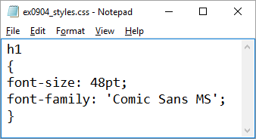
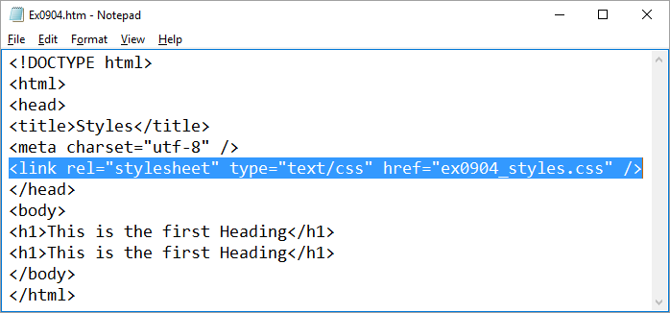
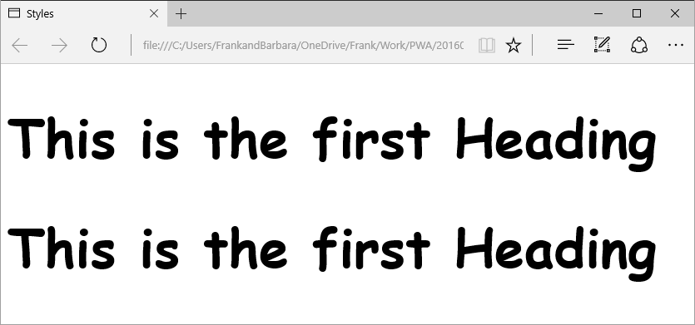
The following HTML document has a link to the stylesheet
And the following output results

Slide 8
CSS format
CSS stands for Cascading Style Sheet and is a simple style formatting language to allow designers to specify styles in a single document to be used by many documents. The word cascading indicates that a single HTML document can link to several CSS documents and many style references can be used for a single tag.
The basic syntax of a css statement is
selector {property: value;}
The selector -> The tag that you want to specify e.g. h1, h2 etc.
The property -> The aspect of the tag that is to be specified e.g. font-family, font-size etc.
The value -> The value of the property e.g. h1 {font-size: 48px;}

Slide 9
It is possible to have several different properties and values for a single selector. The properties are separated by a semicolon e.g.
h1 {
font-size: 48px;
color: yellow;
}
Multiple selectors can be set using a single set of instructions e.g. the following code sets all of the headings to the same font family and colour. After this block the size for each individual heading could be set using further statements.
h1, h2, h3
{
font-family: verdana, arial, 'sans serif';
color: teal;
}

Slide 10
Selectors in specific contexts can be formatted e.g. the following code only sets all of the p tags which occur inside a table. The ones outside the table will not be affected. The difference between this example and the previous is that there is no comma separating the two selectors.
table p
{
font-family: verdana, arial, 'sans serif';
color: teal;
}
A fairly extensive list of values and properties is available at
http://www.w3schools.com/cssref/default.asp
Experiment with the properties to gain an understanding of how they work.

Slide 11
CSS classes
Often you will want to format two paragraphs or headings differently e.g. two <p> tags one as bold and the other as normal text. If they cannot be defined by context as seen above then it is necessary to use classes.
In the HTML document
<p class=”myclass1”>This is normal</p>
<p class=”myclass2”>This is the bold text</p>
Then in the CSS document
p.myclass1{
}
p.myclass2{
font-weight: bold;
}
The tag name comes first then a dot then the name of the class.

Slide 12
CSS IDs
Tags can also be categorised using ids. This allows a single tag on a page to be defined (actually multiples will work mostly unless the ids are being used for other purposes e.g. scripting) and is usually associated with div tags which form the structure of the page e.g. menus, main content etc.
In the HTML document
<div id=”menu”>
<p class=”myclass1”>This is normal</p>
<p class=”myclass2”>This is the bold text</p>
</div>
Then in the CSS document
#menu{
position: absolute;
top: 100px;
left: 100px;
width: 100px;
height: 200px;
}
Note the # which is a reference to an id as opposed to the dot which is a reference to a class.

Slide 13
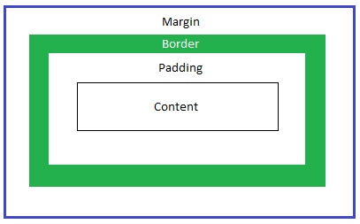
CSS Layout
Layout using Style Sheets
Stylesheets can also be used to layout a webpage on the screen. This is in fact the recommended way as opposed to using tables which are less flexible in that they impose structure within the HTML document which cannot be altered globally by a single stylesheet. Tables can also cause issues with web search engines.
The Box Model
The layout and formatting of the various objects on a page are defined by the box model in the following diagram. It is important to grasp the difference between the four concepts in order to plan the layout of a page.

Slide 14
The content is the information being displayed in the object.
The padding is the space between the content being displayed and the object border. If a background colour is defined for the object then this will be displayed in the padding.
The border is the definitive boundary of the object but if present will have a width (usually in pixels).
The margin is the distance between the border and either the next object or the boundary of the containing object (i.e. one box is contained inside another).
The individual dimensions of each of the four items need to be added together to get the total size
e.g. if the object has a width of 100px, the padding is 5px, the border is 2 px and the margin is 10 px then the total width is 100 + (2*5) + (2*2) + (2*10) = 134px. The items are doubled as there is that amount at each end of the object.

Slide 15
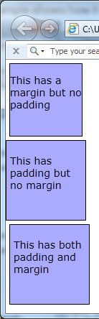
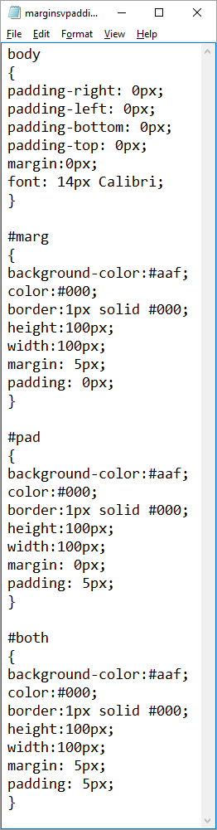
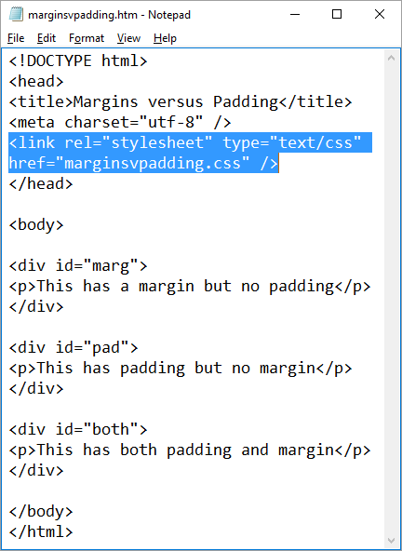
The following example shows how it works in practice.
The top box is set away from the side of the screen due to the transparent margin but the text is flush against the border because there is no padding.
The second box is flush against the screen as there is no margin but the text is set away from the border as there is padding.
The final box has both so is set away from the screen and the text is set away from the border of the box.
Note also the different total width of the objects due to the presence or not of the padding and margins.

Slide 16
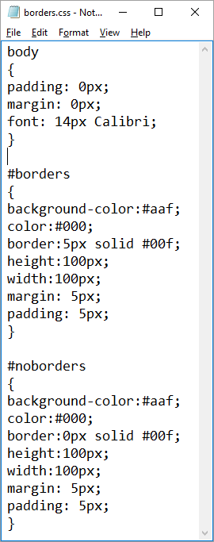
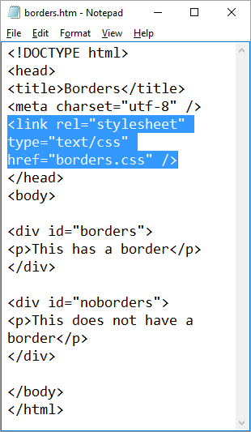
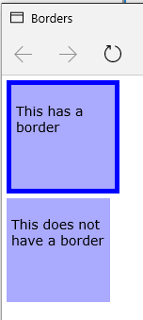
The next example displays the effect of a border on positioning
https://www.w3schools.com/colors/colors_hexadecimal.asp
Note that both have the same margin and padding but the first is set out a further 10px due to the 5px border.

Slide 17
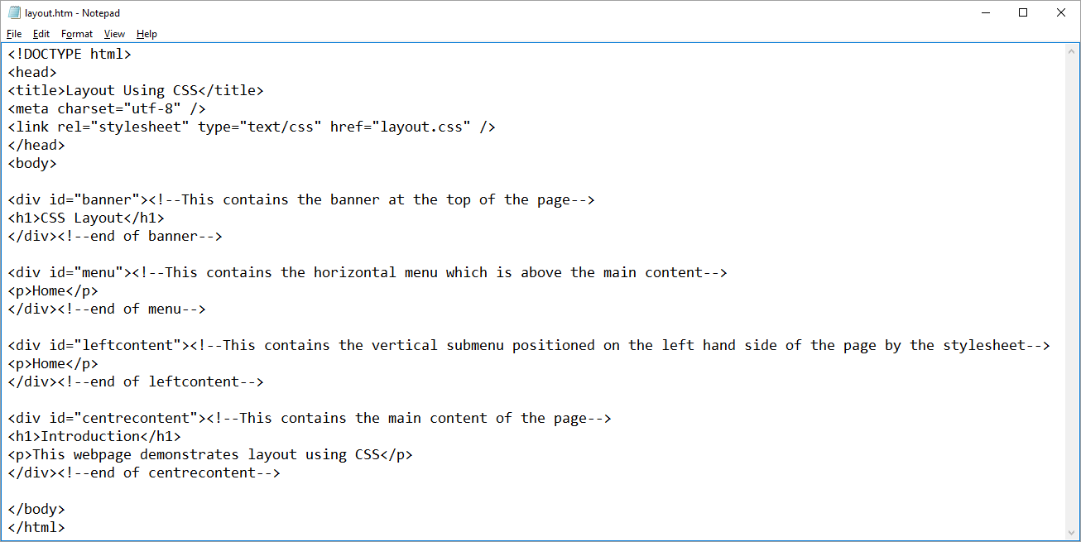
Putting Layout into practice
Each section of the document is separated using a <div id = “XXX”> </div> tag pair and the id is used by the CSS document to identify what formatting to apply to what division. Eg

Slide 18
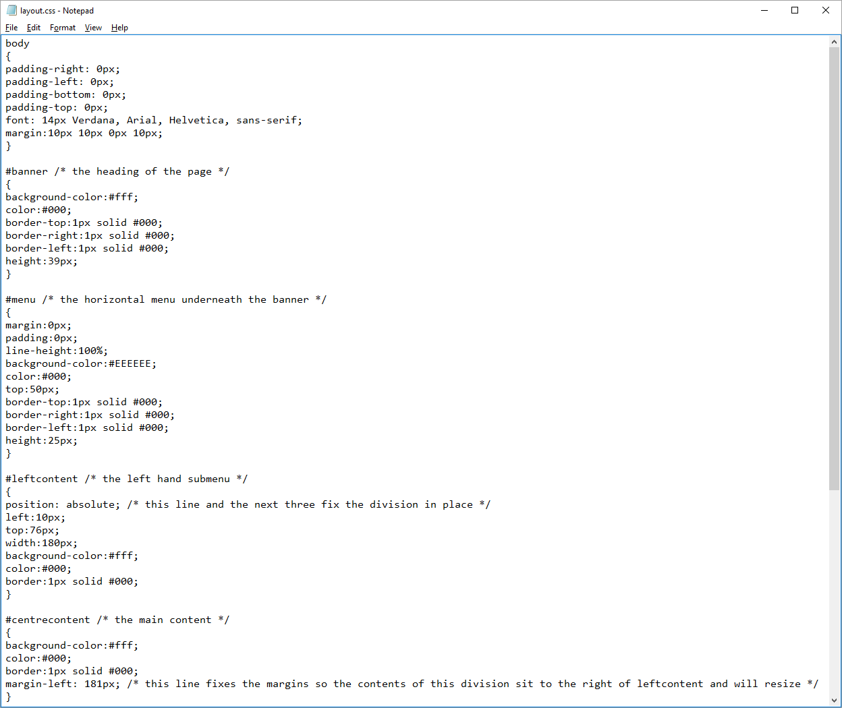

Slide 19
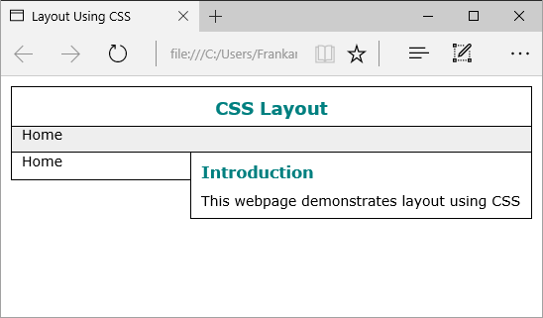
Typically id is used whenever there is only one of that type in the document. The CSS reference uses a # to reference an id rather than the dot used for classes.
The result of these is

Slide 20
Let us now examine in detail how this layout is achieved.
There are four divisions specified banner (CSS Layout), menu (Home under banner), leftcontent (Home on the left) and centrecontent (Introduction etc). The first two and the last are specified using relative positioning. The CSS code for this is
position: relative;
however you will note that this statement does not appear in the CSS code above as it is the default (thus not required). The result of relative positioning is that each of the items involved will be placed directly below the last in keeping with their order in the HTML document. Thus the banner div is at the top of the page, the menu div is directly below it then the centrecontent div is directly below that.

Slide 21
It looks like the centrecontent div has been pushed to one side by the leftcontent div however if you look at the CSS formatting of the centrecontent div you see
#centrecontent /* the main content */
{
background-color:#fff;
color:#000;
border:1px solid #000;
margin-left: 181px; /* this line fixes the margins so the contents of this division sit to the right of leftcontent and will resize */
}
Note that the margin-left has been set to 181 pixels. This leaves a transparent margin space for the final division to be inserted into.
The final division is the leftcontent and this is placed using absolute positioning
#leftcontent /* the left hand submenu */
{
position: absolute; /* this line and the next three fix the division in place */
left:10px;
top:76px;
width:180px;
background-color:#fff;
color:#000;
border:1px solid #000;
}

Slide 22
Absolute positioning will place an object on the screen over the top of any previously defined object. It will also not affect the positioning of any future object. It will also not resize with changes to the window size (which is why we don’t position everything using absolute positioning).
Note we define a specific number of pixels from the left and from the top, then specify a width. No height is specified in this case as we want the division to expand downwards as the content of the division grows.

